Slide 1



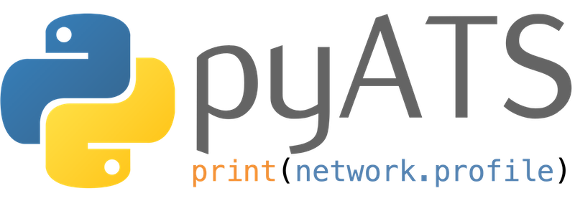
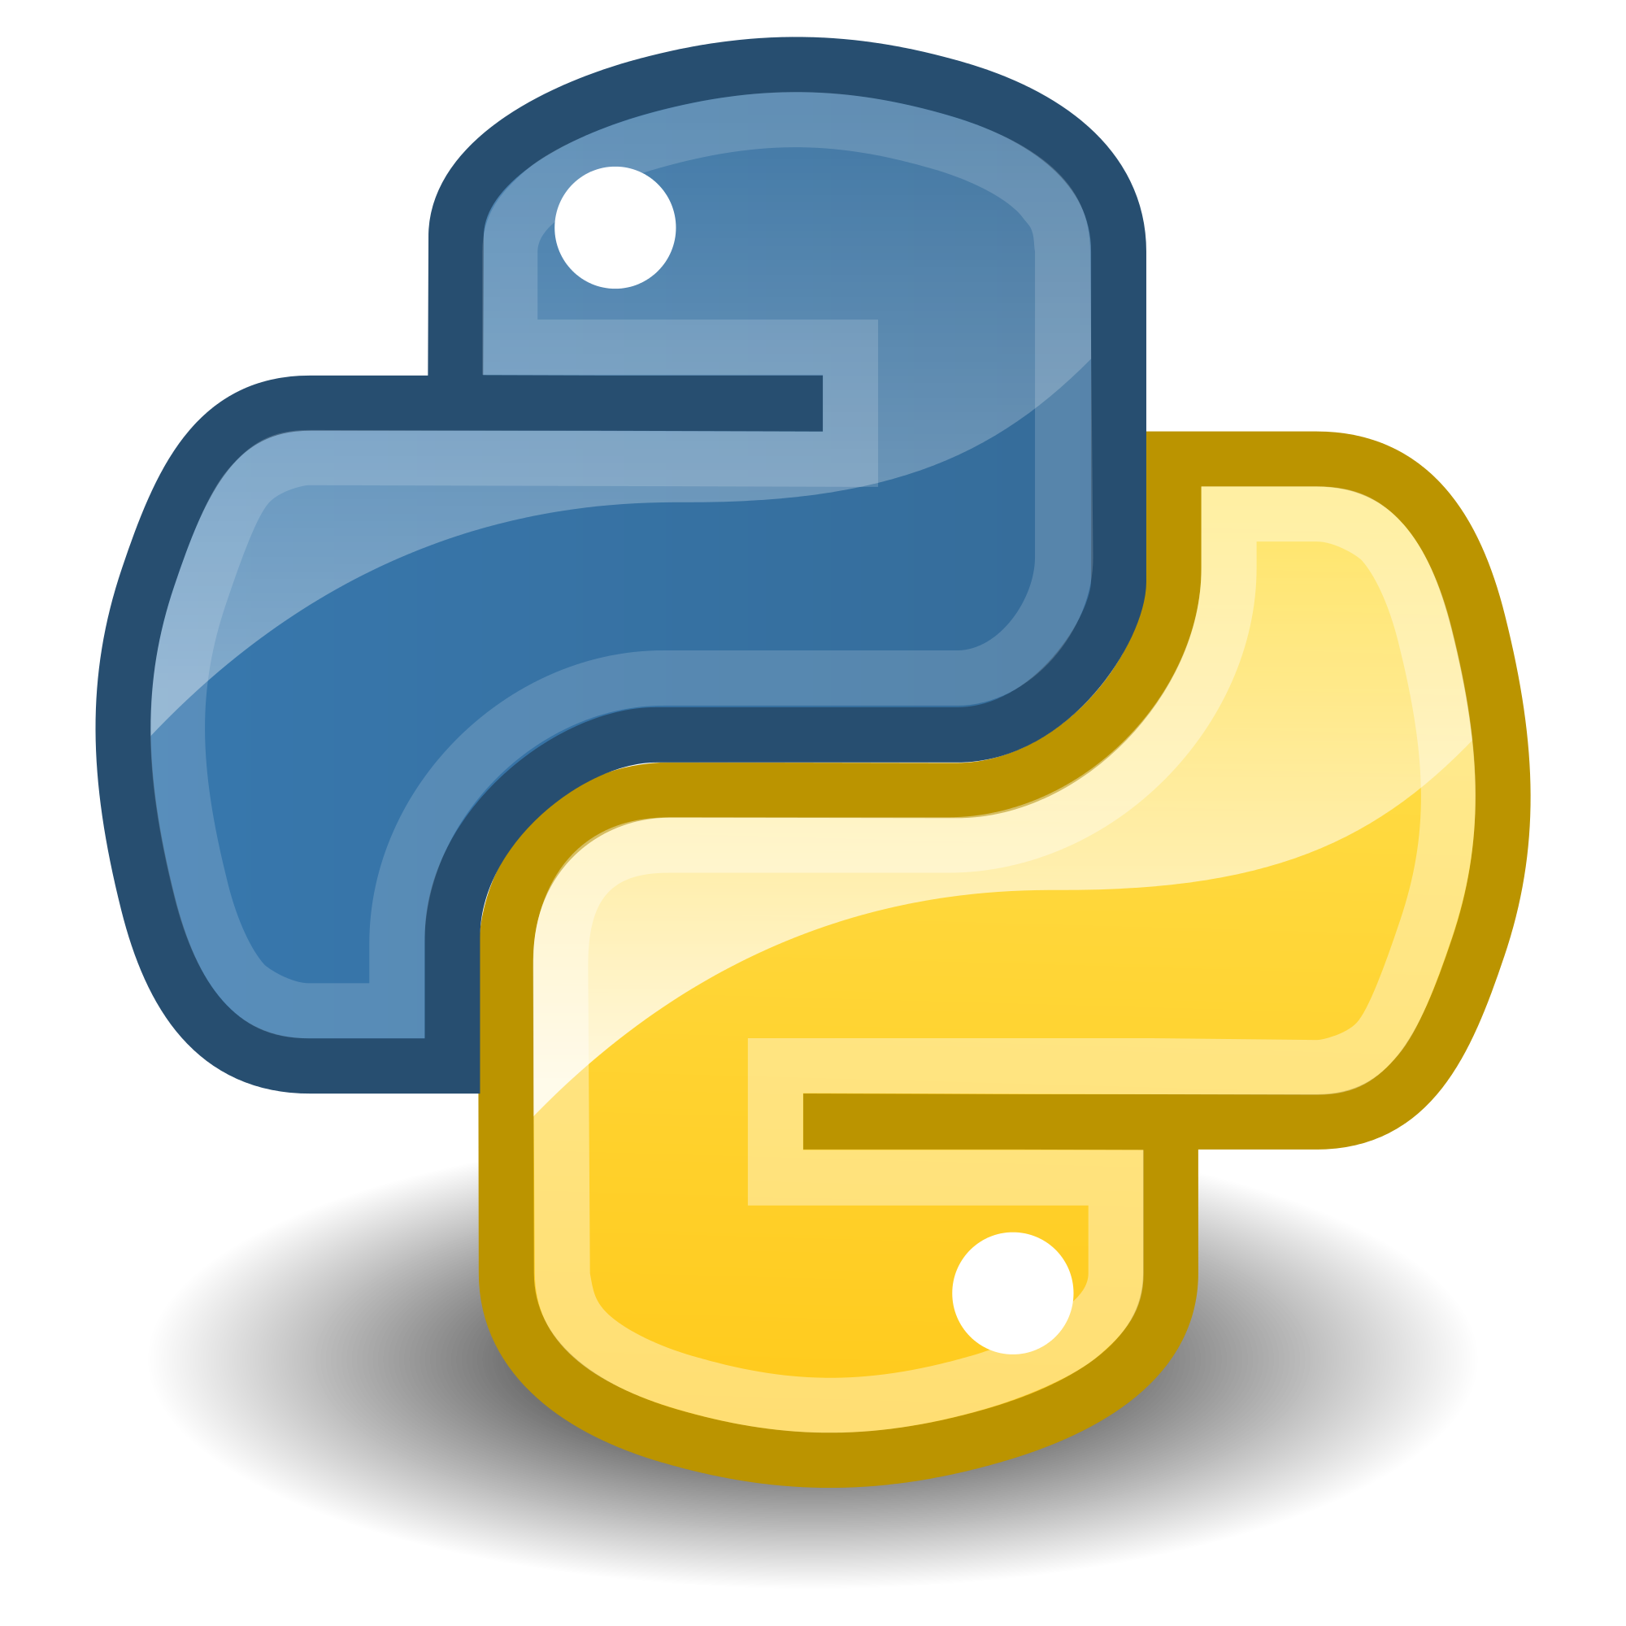


NETWORK
AchaA NetAuto
Network Automation Solutions
Volume-1
Python
Author :
Ankit Chhawsaria
Chandranath Malli Amarnath

Slide 2
Cisco pyATS Network Test & Automation Solution
NETWORK
AchaA NetAuto
Author :
Ankit Chhawsaria Chandranath Malli Amarnath

Slide 3
What is pyATS?
pyATS - Python Automated Test Systems is a Python3 based test automation infrastructure. It is developed as the next-generation Cisco mainstream automation infrastructure, is compatible to existing tooling & infrastructure, and is officially endorsed by Cisco executive team.
pyATS is 100% fully developed and implemented using Python and is designed to be usable independent of any other existing infrastructures. It is engineered to be suitable for Agile, rapid development iterations, with the ability to handle a wide variety of testing scenarios and requirements, from white-box unit-testing, to black-box, feature, performance/scale testing & beyond.
Reference : https://developer.cisco.com/docs/pyats

Slide 4
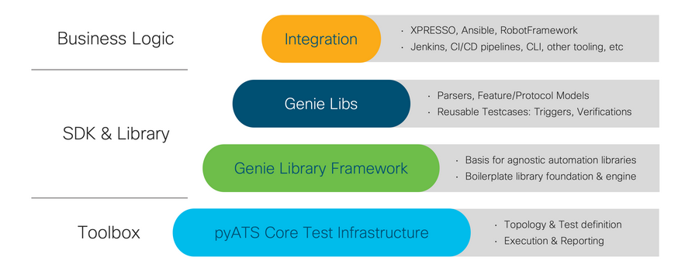
pyATS
pyATS is the core test framework foundation for this ecosystem. It specializes in data-driven and reusable testing, and is engineered for Agile, rapid development iterations.
Genie
Genie and it's compoents how network engineers perform testing and scripting. It comes out of the box with all the bits needed for Network Test Automation, meaning that network engineers and NetDevOps can be productive day one with Genie's readily available and model-driven libraries. Genie has components such as parsers and other methods which allow us to work with networking devices and build our tests around it.
Genie builds on pyATS to provide:
a simple command line interface (no Python knowledge needed)
a pool of reusable test cases
a Pythonic library for more complex scripting

Slide 5
pyATS Hands-on
pyATS Installation
Creating Testbed file
Running pyATS CLI Commands
**Latest copy of presentations, configurations, outputs and reports are maintained in github repository. https://github.com/achaanetatuo/pyats

Slide 6
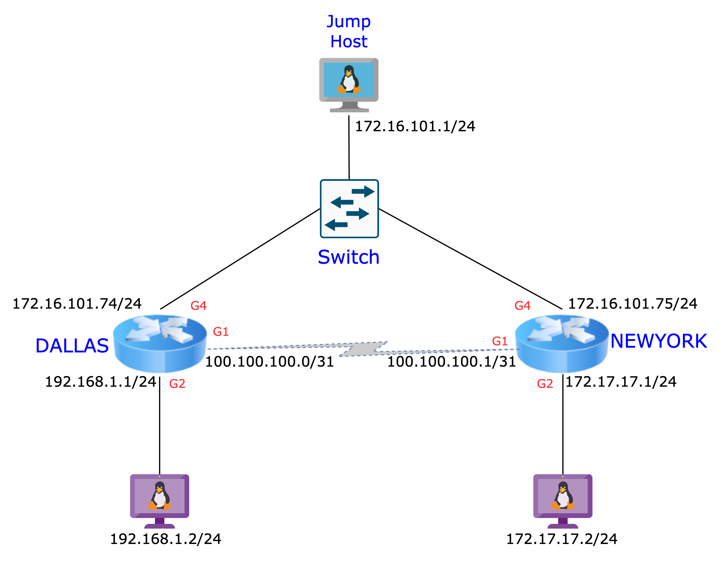
Lab Network Diagram

Slide 7
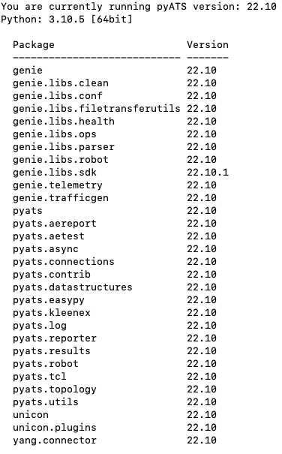
pyATS Installation
pyATS currently supports Python v3.7.x, v3.8.x, v3.9.x and v3.10.x, and is tested to work on the following platforms:
Linux (tested with CentOS, RHEL, Ubuntu, Alpine)
Mac OSX (10.13+)
Step 1: Install pyATS (Mac OS)
% pip install --upgrade 'pyats[full]’
Step 2: Verify pyATS version
% pyats version check
Step 3: Update pyATS version
% pyats version update
Checking your current environment... (...) Uninstalling existing packages... Installing new packages... Done! Enjoy!
Reference : https://developer.cisco.com/docs/pyats/api/

Slide 8
Creating Pyats Testbed File
pyats create testbed interactive --out tb_chan.yaml
% pyats create testbed interactive --out tb_chan.yaml
Start creating Testbed yaml file ...
Do all of the devices have the same username? [y/n] y
Common Username: achaa
Do all of the devices have the same default password? [y/n] y
Common Default Password (leave blank if you want to enter on demand):
Do all of the devices have the same enable password? [y/n] y
Common Enable Password (leave blank if you want to enter on demand):
Device hostname: DALLAS
IP (ip, or ip:port): 172.16.101.62
Protocol (ssh, telnet, ...): ssh
OS (iosxr, iosxe, ios, nxos, linux, ...): iosxe
More devices to add ? [y/n] n
Testbed file generated:
tb_chan.yams
% cat tb_chan.yaml
devices:
DALLAS :
connections:
cli:
ip: 172.16.101.62
protocol: ssh
credentials:
default:
password: '%ASK{}'
username: achaa
enable:
password: '%ASK{}'
os: iosxe
type: iosxe
Referance: https://pubhub.devnetcloud.com/media/genie-docs/docs/clean/user_guide/writing_a_clean/index.html

Slide 9
Example Yaml Files
Directly connected Devices using environment file
Directly connected devices ask password
Store userid and password in environment file
% cat tb_chan_env.yaml
testbed:
name: AchaA Robot
credentials:
default:
username: '%ENV{PYATS_DEVICE_USERNAME}'
password: '%ENV{PYATS_DEVICE_PASSWORD}'
enable:
password: '%ENV{PYATS_DEVICE_PASSWORD}'
line:
password: '%ENV{PYATS_DEVICE_PASSWORD}'
devices:
DALLAS:
alias: DAL
connections:
ssh:
ip: 172.16.101.62
protocol: ssh
custom:
abstraction:
order:
- os
- platform
os: iosxe
platform: iosxe
type: CSR1000V
NEWYORK:
alias: NY
connections:
ssh:
ip: 172.16.101.63
protocol: ssh
custom:
abstraction:
order:
- os
- platform
os: iosxe
platform: iosxe
type: CSR1000V
% cat tb_chan.yaml
devices:
DALLAS:
connections:
cli:
ip: 172.16.101.62
protocol: ssh
credentials:
default:
password: '%ASK{}'
username: achaa
enable:
password: '%ASK{}'
os: iosxe
type: iosxe
NEWYORK:
connections:
cli:
ip: 172.16.101.63
protocol: ssh
credentials:
default:
password: '%ASK{}'
username: achaa
enable:
password: '%ASK{}'
os: iosxe
type: iosxe
% cat pyats.env
export PYATS_DEVICE_USERNAME=achaa
export PYATS_DEVICE_PASSWORD= achaa12345
export PYATS_DEVICE_ENABLE= achaa12345

Slide 10
Example Yaml Files
Devices connected via Jump host uses environment file
testbed:
name: AchaA Robot
credentials:
default:
username: '%ENV{PYATS_DEVICE_USERNAME}'
password: '%ENV{PYATS_DEVICE_PASSWORD}'
enable:
password: '%ENV{PYATS_DEVICE_PASSWORD}'
line:
password: '%ENV{PYATS_DEVICE_PASSWORD}'
servers:
username: '%ENV{PYATS_LINUX_USERNAME}'
password: '%ENV{PYATS_LINUX_PASSWORD}'
devices:
DALLAS:
alias: DAL
connections:
ssh:
ip: 172.16.101.74
protocol: ssh
proxy: jump_host
custom:
abstraction:
order:
- os
- platform
os: iosxe
platform: iosxe
type: CSR1000V
NEWYORK:
alias: NY
connections:
ssh:
ip: 172.16.101.75
protocol: ssh
proxy: jump_host
custom:
abstraction:
order:
- os
- platform
os: iosxe
platform: iosxe
type: CSR1000V
Cont….
jump_host:
connections:
cli:
ip: 172.16.101.1
port: 22
protocol: ssh
credentials:
default:
username: achaa
os: linux
type: linux
Store userid and password in environment file
% cat pyats.env
export PYATS_DEVICE_USERNAME=achaa
export PYATS_DEVICE_PASSWORD=achaa12345
export PYATS_DEVICE_ENABLE=achaa12345
export PYATS_LINUX_USERNAME=achaa
export PYATS_LINUX_PASSWORD=achaa12345

Slide 11
Pyats Genie Command Line
Genie CLI is the easiest way to start with Genie. No need any automation or Python knowledge. As long as Genie is installed, you can interact with the Genie libraries with a Linux command.
Here’s what you can do:
Parse show command into structured output
Learn whole device feature into structured output
Compare structured output taken at different time
Genie shell to load the testbed file and/or pickle file.
Run Genie Harness without any jobfile
Refernce: https://developer.cisco.com/docs/genie-docs/

Slide 12
Pyats Genie Command Line
Modules
pyats learn config --testbed-file tb-jump.yaml --output today
pyats learn interface --testbed-file tb-jump.yaml --output today
pyats learn interface --testbed-file tb-jump.yaml --output today -–device DAL
pyats learn interface bgp ospf --testbed-file tb-jump.yaml --output int_bgp_ospf –-device DAL
Parse
pyats parse "show version" --testbed-file tb-jump.yaml --output version
pyats parse "show version" --testbed-file tb-jump.yaml --output version_noparse –-raw
Compare
pyats diff data_10_21_2022_NY_int date_10_22_2022_NY_int --output diff_NY_int
More Genie functions or commands
'clean', 'create', 'develop', 'diff', 'dnac', 'learn', 'logs', 'parse', 'run', 'secret', 'shell', 'undevelop', 'validate', 'version'
Refernce: https://pubhub.devnetcloud.com/media/genie-docs/docs/solutions/index.html

Slide 13
Pyats Robot Framework
Overview
Installation
Keyword vs. Library architecture
Basic Syntax, Command-line usage, I/O
Network Automation with ROBOT Framework
Device connectivity
Invoking parsers and profiling feature operational status
Output/state comparisons Integration with Traffic Generators
Recommended tool for code editing : Microsoft Virtual Studio
Download link: https://visualstudio.microsoft.com/downloads/

Slide 14
Pyats Robot Framework
Overview
Robot Framework is generic Python/Java test automation framework that focuses on acceptance test automation by through English-like keyword-driven test approach.
Robot Framework support has been added through the optional robot sub-package under Genie.libs namespace. This enables RobotFramework users to leverage key aspects of Genie without having to reinvent the wheel. Robot Framework libraries have also been added for pyATS and Unicon.
Open-Source
Generic Test Automation Infrastructure, for TDD/A-TDD
Uses keyword-driven approach to define test actions & testcases
Test capabilities are extended by test libraries
Anyone can create new higher-level keywords from existing ones
OS/Application independent, based on Python
Generates XML and HTML report
Installation
Robot Framework support is an optional component under Genie. To use it, you must install this package explicitly:
pip install --upgrade genie.libs.robot

Slide 15
Pyats Robot Framework
Features
Genie Triggers and converting results to Robot
Genie Verifications and converting results to Robot
Execute Genie Ops object to learn about a feature
Metaparser support (Can re-use any existing parser)
Custom verify functions, such as:
Verify x amount of bgp routes on a device
Verify x amount of up interfaces on a device
Genie configure to configure interfaces.
Genie Profile to capture the snapshots using Genie models
Genie Compare snapshots to get a results.
Genie Device API support, all API functions can be used as a keyword, simply replace the ‘_’ to a space and put it in your .robot file with the arguments. Make sure to import genie.libs.robot.GenieRobotApis as a library.
Reference : https://pubhub.devnetcloud.com/media/genie-docs/docs/userguide/robot/index.html

Slide 16
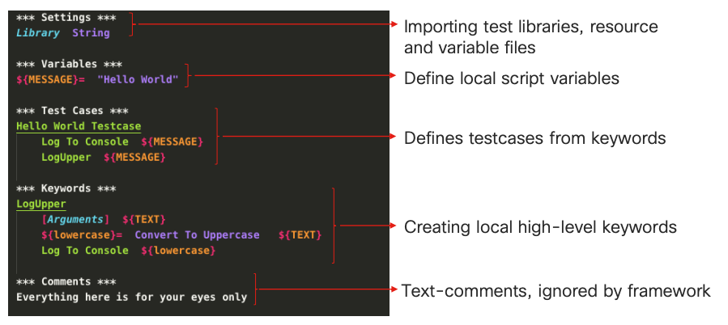
Pyats Robot Framework Section

Slide 17
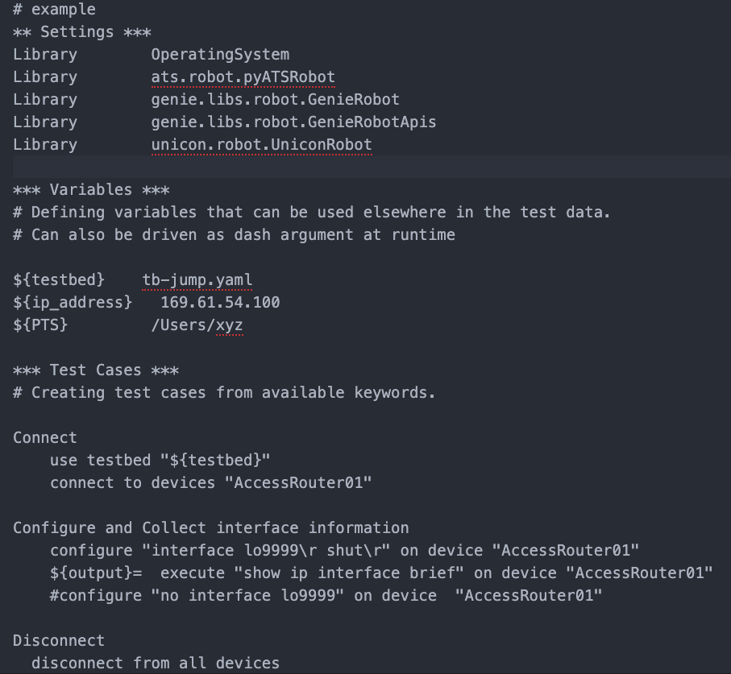
Pyats Robot Framework Section
Example
Importing Libraries
Calling Variables
Connecting devices
Using features to configure and gathering output from devices
Disconnecting devices

Slide 18
Pyats Robot Framework – Execute Running Configuration
Robot config file (show_run.robot)
Robot config file execution and output
# Show Running Configuration
** Settings ***
Library OperatingSystem
Library ats.robot.pyATSRobot
Library genie.libs.robot.GenieRobot
Library genie.libs.robot.GenieRobotApis
Library unicon.robot.UniconRobot
*** Variables ***
# Defining variables that can be used elsewhere in the test data.
# Can also be driven as dash argument at runtime
${testbed} tb-jump.yaml
*** Test Cases ***
# Creating test cases from available keywords.
Connect
use testbed "${testbed}"
connect to devices "DAL"
connect to devices "NY"
# Dallas Running Configuration
DAL Running Configuration
execute "show running-config" on device "DAL"
# Newyork Running Configuration
NY Running Configuration
execute "show running-config" on device "NY"
# Disconnect from all the devices
Disconnect
disconnect from all devices
Mac-Pro-641 robot % robot show_run.robot
==============================================================================
Show Run
==============================================================================
Connect | PASS |
------------------------------------------------------------------------------
DAL Running Configuration | PASS |
------------------------------------------------------------------------------
NY Running Configuration | PASS |
------------------------------------------------------------------------------
Disconnect | PASS |
------------------------------------------------------------------------------
Show Run | PASS |
4 tests, 4 passed, 0 failed
==============================================================================
Output: /Users/Mac-Pro-641/myfolder/autolearn/robot/output.xml
Log: /Users/Mac-Pro-641/myfolder/autolearn/robot/log.html
Report: /Users/Mac-Pro-641/myfolder/autolearn/robot/report.html
Consolidated Ouput log file log.html
Log: /Users/Mac-Pro-641/myfolder/autolearn/robot/log.html
Opening log.html
Mac-Pro-641 robot % open log.html
https://github.com/achaanetatuo/pyats/tree/main/robot-config

Slide 19
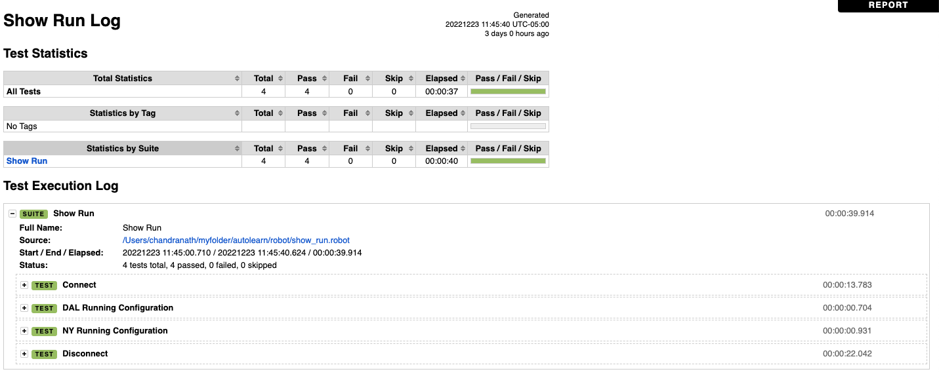
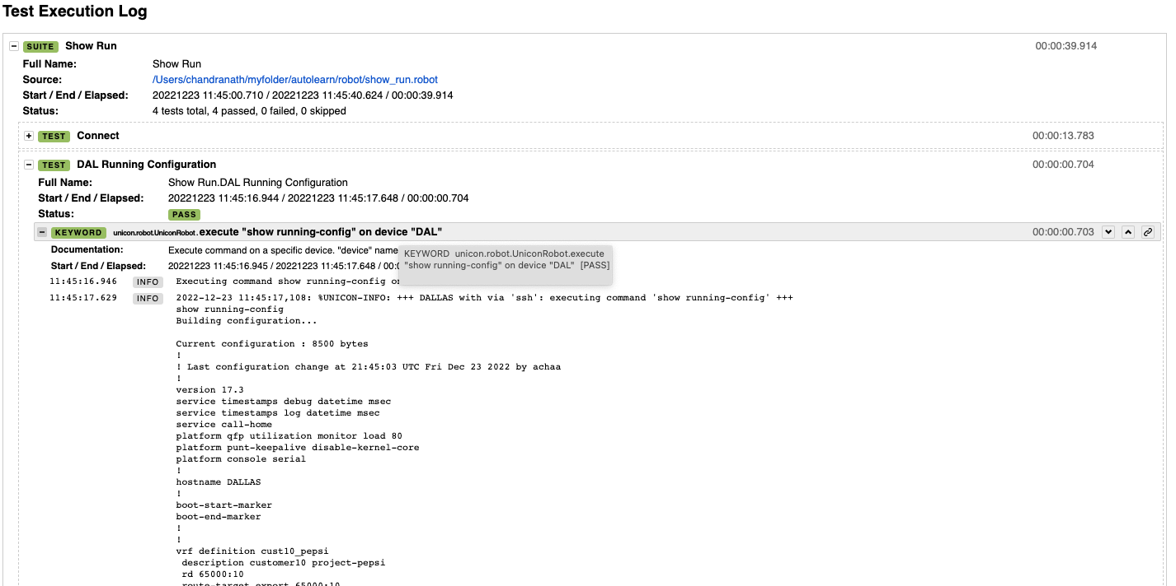
Report - Execute Running Configuration (Report Log)
Consolidated Report file “log.html”
/Users/Mac-Pro-641/myfolder/autolearn/robot/log.html
Opening “log.html”
Mac-Pro-641 robot % open log.html
https://github.com/achaanetatuo/pyats/blob/main/report_log
https://github.com/achaanetatuo/pyats/blob/main/report_log/1_show_run.html

Slide 20
Pyats Robot Framework – View Interface Information and Status
# Show Interface Configuration
** Settings ***
Library OperatingSystem
Library ats.robot.pyATSRobot
Library genie.libs.robot.GenieRobot
Library genie.libs.robot.GenieRobotApis
Library unicon.robot.UniconRobot
*** Variables ***
# Defining variables that can be used elsewhere in the test data.
# Can also be driven as dash argument at runtime
${testbed} tb-jump.yaml
# ${PTS} /path/file
*** Test Cases ***
# Creating test cases from available keywords.
Connect
use testbed "${testbed}"
connect to devices "DAL"
connect to devices "NY"
# Dallas Interface Configuration
DAL Interface Configuration
execute "show ip interface brief" on device "DAL"
execute "show Interface GigabitEthernet1" on device "DAL”
# Newyork Interface Configuration
NY Interface Configuration
execute "show ip interface brief" on device "NY"
execute "show Interface GigabitEthernet1" on device "NY"
# Disconnect from all the devices
Disconnect
disconnect from all devices
Mac-Pro-641 robot % robot show_interface.robot
==============================================================================
Show Interface
==============================================================================
Connect | PASS |
------------------------------------------------------------------------------
DAL Interface Configuration | PASS |
------------------------------------------------------------------------------
NY Interface Configuration | PASS |
------------------------------------------------------------------------------
Disconnect | PASS |
------------------------------------------------------------------------------
Show Interface | PASS |
4 tests, 4 passed, 0 failed
==============================================================================
Output: /Users/Mac-Pro-641/myfolder/autolearn/robot/output.xml
Log: /Users/Mac-Pro-641/myfolder/autolearn/robot/log.html
Report: /Users/Mac-Pro-641/myfolder/autolearn/robot/report.html
Mac-Pro-641 robot %

Slide 21
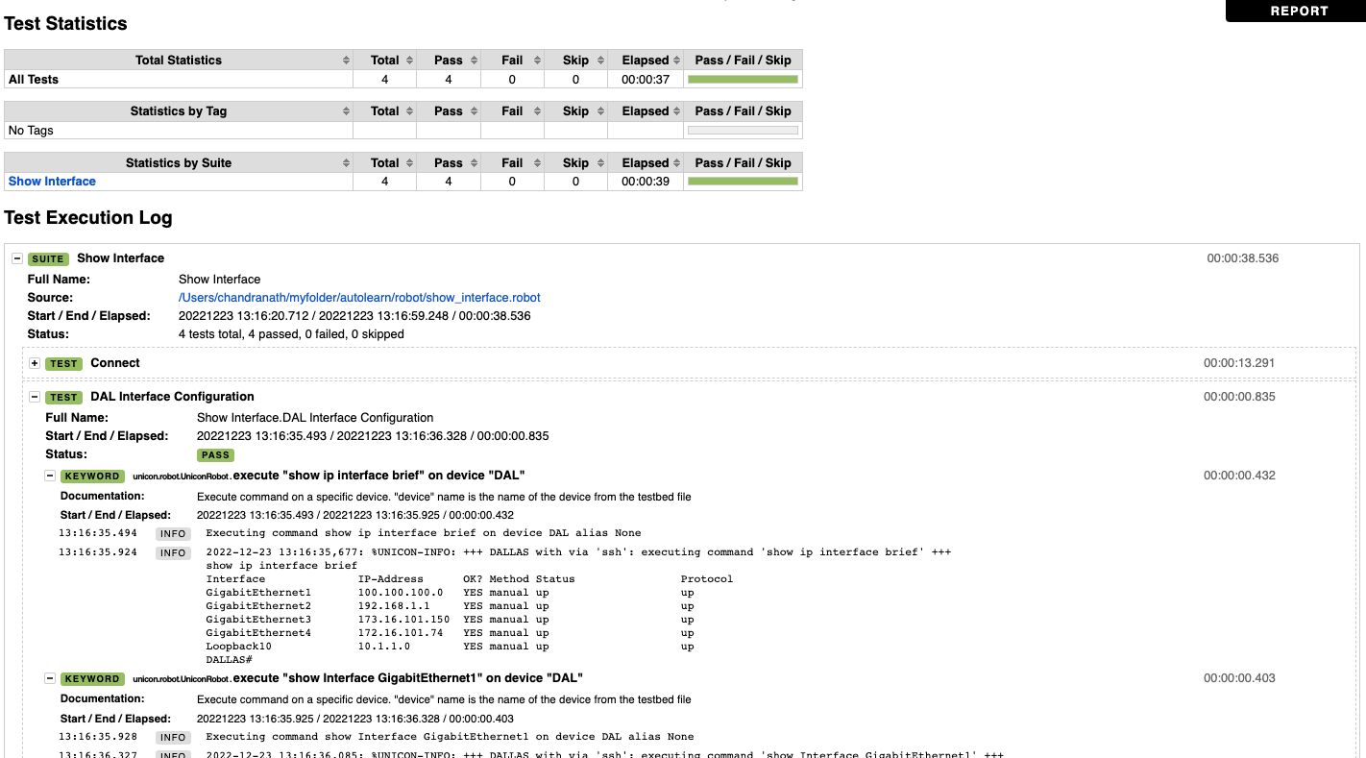
Report - View Interface Information and Status
https://github.com/achaanetatuo/pyats/blob/main/report_log/2_show_interface.html

Slide 22
Pyats Robot Framework – View Routing Table
# View Routing Table
** Settings ***
Library OperatingSystem
Library ats.robot.pyATSRobot
Library genie.libs.robot.GenieRobot
Library genie.libs.robot.GenieRobotApis
Library unicon.robot.UniconRobot
*** Variables ***
# Defining variables that can be used elsewhere in the test data.
# Can also be driven as dash argument at runtime
${testbed} tb-jump.yaml
# ${PTS} /path/file
*** Test Cases ***
# Creating test cases from available keywords.
Connect
use testbed "${testbed}"
connect to devices "DAL"
connect to devices "NY"
# Dallas Routing Table
DAL Routing Table
execute "show ip route" on device "DAL"
# Newyork Routing Table
NY Routing Table
execute "show ip route" on device "NY"
# Disconnect from all the devices
Disconnect
disconnect from all devices
Mac-Pro-641 robot % robot show_route.robot
==============================================================================
Show Route
==============================================================================
Connect | PASS |
------------------------------------------------------------------------------
DAL Routing Table | PASS |
------------------------------------------------------------------------------
NY Routing Table | PASS |
------------------------------------------------------------------------------
Disconnect | PASS |
------------------------------------------------------------------------------
Show Route | PASS |
4 tests, 4 passed, 0 failed
==============================================================================
Output: /Users/Mac-Pro-641/myfolder/autolearn/robot/output.xml
Log: /Users/Mac-Pro-641/myfolder/autolearn/robot/log.html
Report: /Users/Mac-Pro-641/myfolder/autolearn/robot/report.html

Slide 23
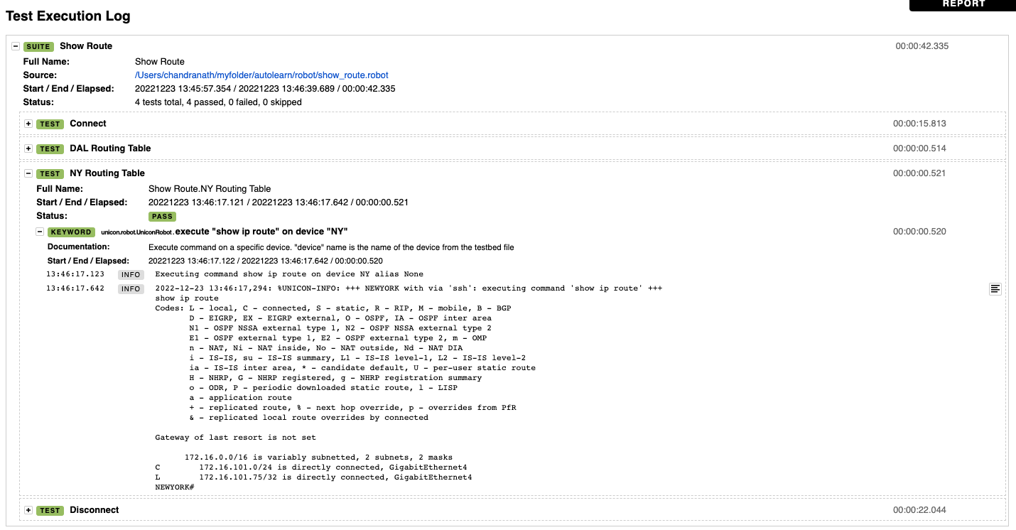
Report - View Routing Table
https://github.com/achaanetatuo/pyats/blob/main/report_log/3_show_route.html

Slide 24
Pyats Robot Framework – Parsing IP Route
# Parse Show IP Route
** Settings ***
Library OperatingSystem
Library ats.robot.pyATSRobot
Library genie.libs.robot.GenieRobot
Library genie.metaparser
Library genie.libs.parser
Library genie.libs.robot.GenieRobotApis
Library unicon.robot.UniconRobot
*** Variables ***
# Defining variables that can be used elsewhere in the test data.
# Can also be driven as dash argument at runtime
${testbed} tb-jump.yaml
# ${PTS} /path/file
*** Test Cases ***
# Creating test cases from available keywords.
Connect
use testbed "${testbed}"
connect to devices "DAL"
connect to devices "NY"
Parse Route output
${output} = parse "show ip route vrf cust20_pepsi" on device "NY"
Log ${output}
# Disconnect from all the devices
Disconnect
disconnect from all devices
Mac-Pro-641 robot % robot show_route_parsh.robot
==============================================================================
Show Route Parsh
==============================================================================
Connect | PASS |
------------------------------------------------------------------------------
Parse Route output | PASS |
------------------------------------------------------------------------------
Disconnect | PASS |
------------------------------------------------------------------------------
Show Route Parsh | PASS |
3 tests, 3 passed, 0 failed
==============================================================================
Output: /Users/chandranath/myfolder/autolearn/robot/output.xml
Log: /Users/chandranath/myfolder/autolearn/robot/log.html
Report: /Users/chandranath/myfolder/autolearn/robot/report.html

Slide 25
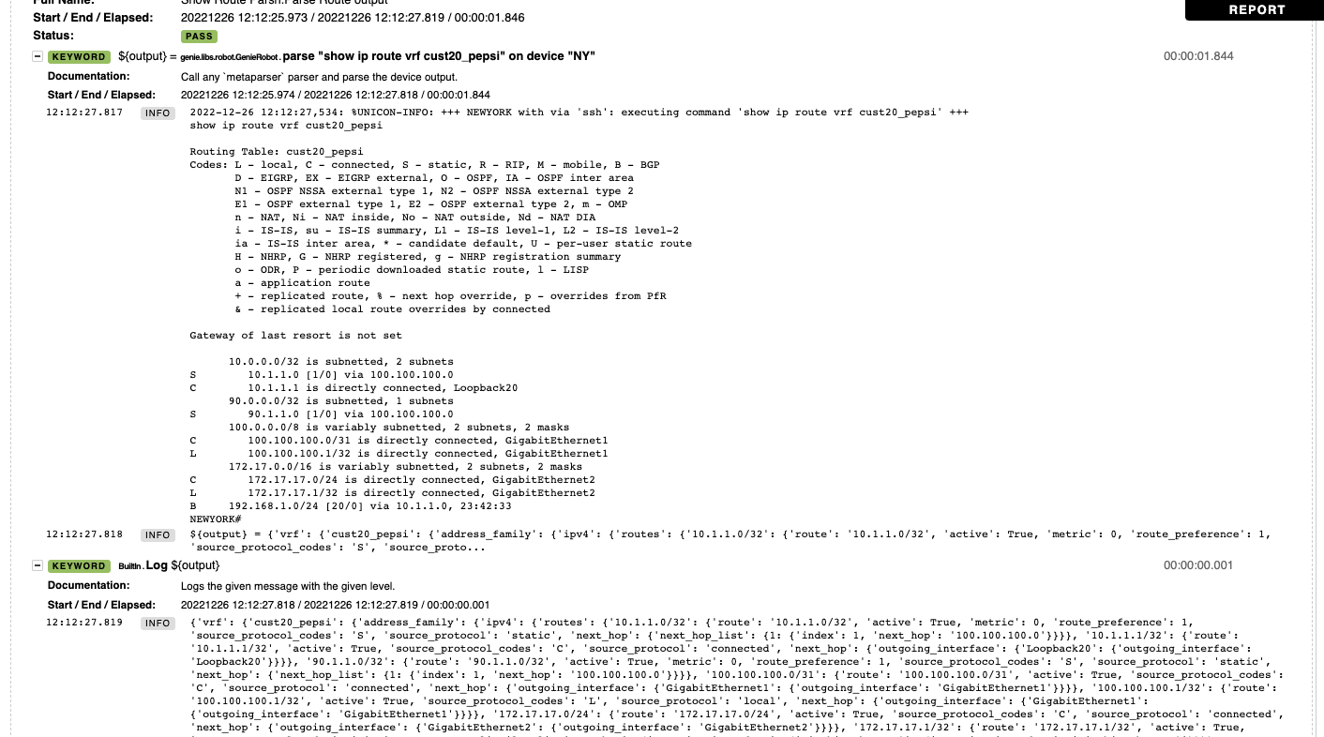
Report – Parsing IP Route
https://github.com/achaanetatuo/pyats/blob/main/report_log/4_show_route_parsh.html

Slide 26
Pyats Robot Framework – Parsing and Filtering
# Parse and Filter IP Route
** Settings ***
Library OperatingSystem
Library ats.robot.pyATSRobot
Library genie.libs.robot.GenieRobot
Library genie.metaparser
Library genie.libs.parser
Library genie.libs.robot.GenieRobotApis
Library unicon.robot.UniconRobot
*** Variables ***
# Defining variables that can be used elsewhere in the test data.
# Can also be driven as dash argument at runtime
${testbed} tb-jump.yaml
# ${PTS} /path/file
*** Test Cases ***
# Creating test cases from available keywords.
Connect
use testbed "${testbed}"
connect to devices "DAL"
connect to devices "NY"
Parse and Filter Route output
${output} = parse "show ip route vrf cust20_pepsi" on device "NY"
Log ${output}
${output2} = Dq query data=${output} filters=contains('bgp').get_values('routes')
Log ${output2}
# Disconnect from all the devices
Disconnect
disconnect from all devices
-Mac-Pro-641 robot % robot route_parsh_filter.robot
==============================================================================
Route Parsh Filter
==============================================================================
Connect | PASS |
------------------------------------------------------------------------------
Parse and Filter Route output | PASS |
------------------------------------------------------------------------------
Disconnect | PASS |
------------------------------------------------------------------------------
Route Parsh Filter | PASS |
3 tests, 3 passed, 0 failed
==============================================================================
Output: /Users/chandranath/myfolder/autolearn/robot/output.xml
Log: /Users/chandranath/myfolder/autolearn/robot/log.html
Report: /Users/chandranath/myfolder/autolearn/robot/report.html

Slide 27
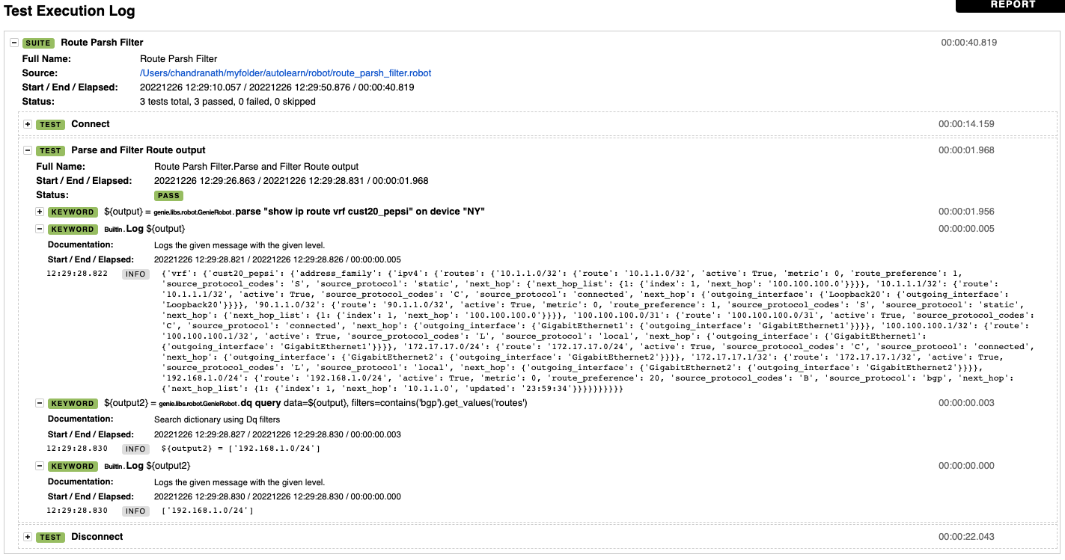
Report – Parsing and Filtering
https://github.com/achaanetatuo/pyats/blob/main/report_log/5_route_parsh_filter.html

Slide 28
Pyats Robot Framework – Modify Interface Settings
# View Shut and Unshut Interface
** Settings ***
Library OperatingSystem
Library ats.robot.pyATSRobot
Library genie.libs.robot.GenieRobot
Library genie.metaparser
Library genie.libs.parser
Library genie.libs.robot.GenieRobotApis
Library unicon.robot.UniconRobot
*** Variables ***
# Defining variables that can be used elsewhere in the test data.
# Can also be driven as dash argument at runtime
${testbed} tb-jump.yaml
# ${PTS} /path/file
*** Test Cases ***
# Creating test cases from available keywords.
Connect
use testbed "${testbed}"
connect to devices "DAL"
connect to devices "NY"
Shutdown NY Interface GigabitEthernet1
shut interface interface=GigabitEthernet1 device=NY
verify interface config shutdown interface=GigabitEthernet1 device=NY
Unshutdown NY Interface GigabitEthernet1
unshut interface interface=GigabitEthernet1 device=NY
verify interface config shutdown interface=GigabitEthernet1 device=NY
# Disconnect from all the devices
Disconnect
disconnect from all devices
Mac-Pro-641 robot % robot Modify_interface.robot
==============================================================================
Modify interface
==============================================================================
Connect | PASS |
------------------------------------------------------------------------------
Shutdown NY Interface GigabitEthernet1 | PASS |
------------------------------------------------------------------------------
Unshutdown NY Interface GigabitEthernet1 | PASS |
------------------------------------------------------------------------------
Disconnect | PASS |
------------------------------------------------------------------------------
Modify interface | PASS |
4 tests, 4 passed, 0 failed
==============================================================================
Output: /Users/chandranath/myfolder/autolearn/robot/output.xml
Log: /Users/chandranath/myfolder/autolearn/robot/log.html
Report: /Users/chandranath/myfolder/autolearn/robot/report.html

Slide 29
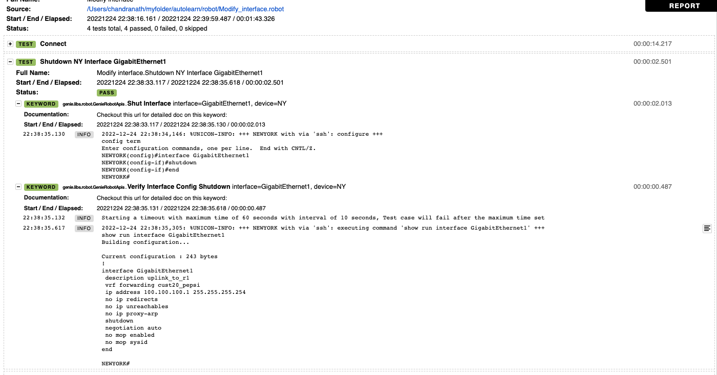
Report – Modify Interface Settings
https://github.com/achaanetatuo/pyats/blob/main/report_log/6_Modify_interface.html

Slide 30
Pyats Robot Framework – Configure New Static Route
# View Remove and Add Static Route
** Settings ***
Library OperatingSystem
Library ats.robot.pyATSRobot
Library genie.libs.robot.GenieRobot
Library genie.metaparser
Library genie.libs.parser
Library genie.libs.robot.GenieRobotApis
Library unicon.robot.UniconRobot
*** Variables ***
# Defining variables that can be used elsewhere in the test data.
# Can also be driven as dash argument at runtime
${testbed} tb-jump.yaml
# ${PTS} /path/file
*** Test Cases ***
# Creating test cases from available keywords.
Connect
use testbed "${testbed}"
connect to devices "DAL"
connect to devices "NY"
Remove Static Route
execute "show ip route vrf cust20_pepsi" on device "NY"
configure "no ip route vrf cust20_pepsi 10.1.1.0 255.255.255.255 100.100.100.0" on device "NY"
Sleep 10
execute "show ip route vrf cust20_pepsi" on device "NY"
Add Static Route
configure "ip route vrf cust20_pepsi 10.1.1.0 255.255.255.255 100.100.100.0" on device "NY"
Sleep 10
execute "show ip route vrf cust20_pepsi" on device "NY"
# Disconnect from all the devices
Disconnect
disconnect from all devices
Mac-Pro-641 robot % robot config_static_route.robot
==============================================================================
Config Static Route
==============================================================================
Connect | PASS |
------------------------------------------------------------------------------
Remove Static Route | PASS |
------------------------------------------------------------------------------
Add Static Route | PASS |
------------------------------------------------------------------------------
Disconnect | PASS |
------------------------------------------------------------------------------
Config Static Route | PASS |
4 tests, 4 passed, 0 failed
==============================================================================
Output: /Users/chandranath/myfolder/autolearn/robot/output.xml
Log: /Users/chandranath/myfolder/autolearn/robot/log.html
Report: /Users/chandranath/myfolder/autolearn/robot/report.html

Slide 31
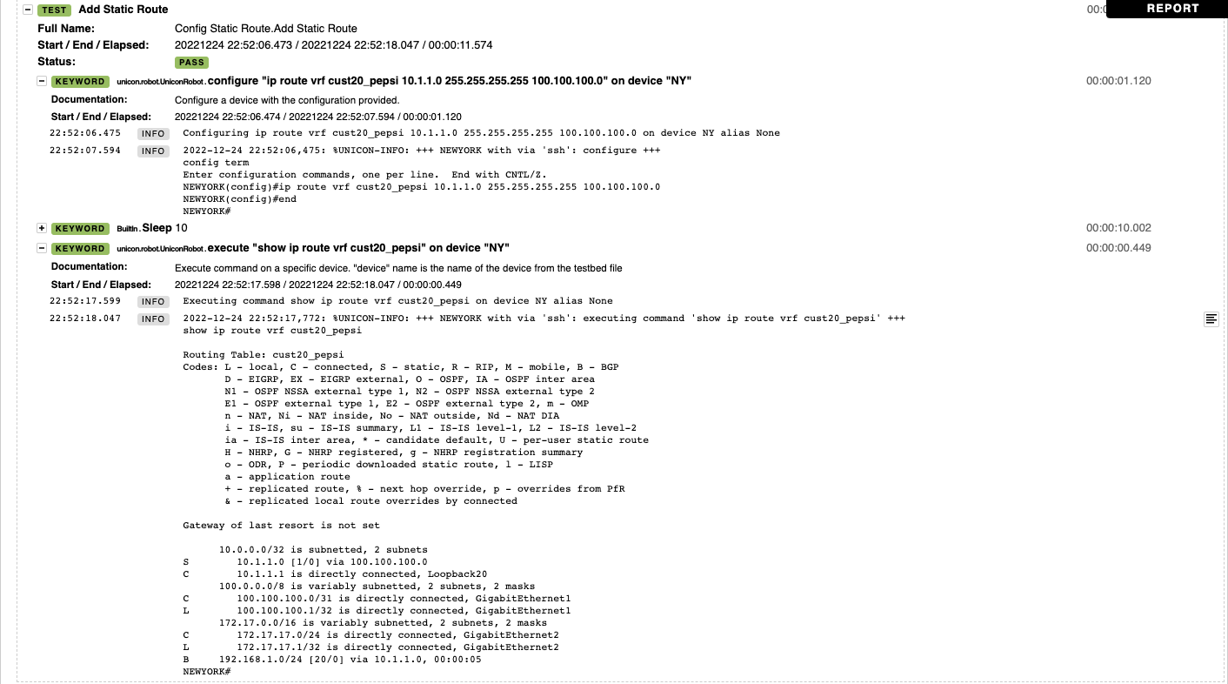
Report – Configure New Static Route
https://github.com/achaanetatuo/pyats/blob/main/report_log/7_config_static_route.html

Slide 32
Pyats Robot Framework – Shut and Unshut BGP Peer
# Shut and unshut BGP Peer
** Settings ***
Library OperatingSystem
Library ats.robot.pyATSRobot
Library genie.libs.robot.GenieRobot
Library genie.metaparser
Library genie.libs.parser
Library genie.libs.robot.GenieRobotApis
Library unicon.robot.UniconRobot
*** Variables ***
# Defining variables that can be used elsewhere in the test data.
# Can also be driven as dash argument at runtime
${testbed} tb-jump.yaml
@{bgpshut} 10.1.1.0
# ${PTS} /path/file
*** Test Cases ***
# Creating test cases from available keywords.
Connect
use testbed "${testbed}"
connect to devices "DAL"
connect to devices "NY"
Shut BGP Peer
execute "show ip route vrf cust20_pepsi" on device "NY"
execute "show run | sec bgp" on device "NY"
configure shut bgp neighbors bgp_as=65010 address_family=ipv4 vrf=cust20_pepsi device=NY neighbors=@{bgpshut}
execute "show run | sec bgp" on device "NY"
Sleep 10
execute "show ip route vrf cust20_pepsi" on device "NY"
UnShutdown BGP Peer
configure shut bgp neighbors bgp_as=65010 address_family=ipv4 vrf=cust20_pepsi device=NY neighbors=@{bgpshut} noshut=True
execute "show run | sec bgp" on device "NY"
Sleep 10
execute "show ip route vrf cust20_pepsi" on device "NY"
# Disconnect from all the devices
Disconnect
disconnect from all devices
Mac-Pro-641 robot % robot shut_bgp_peer.robot
==============================================================================
Shut Bgp Peer
==============================================================================
Connect | PASS |
------------------------------------------------------------------------------
Shut BGP Peer | PASS |
------------------------------------------------------------------------------
UnShutdown BGP Peer | PASS |
------------------------------------------------------------------------------
Disconnect | PASS |
------------------------------------------------------------------------------
Shut Bgp Peer | PASS |
4 tests, 4 passed, 0 failed
==============================================================================
Output: /Users/chandranath/myfolder/autolearn/robot/output.xml
Log: /Users/chandranath/myfolder/autolearn/robot/log.html
Report: /Users/chandranath/myfolder/autolearn/robot/report.html
**Sleep used to wait for certain seconds before run next command

Slide 33
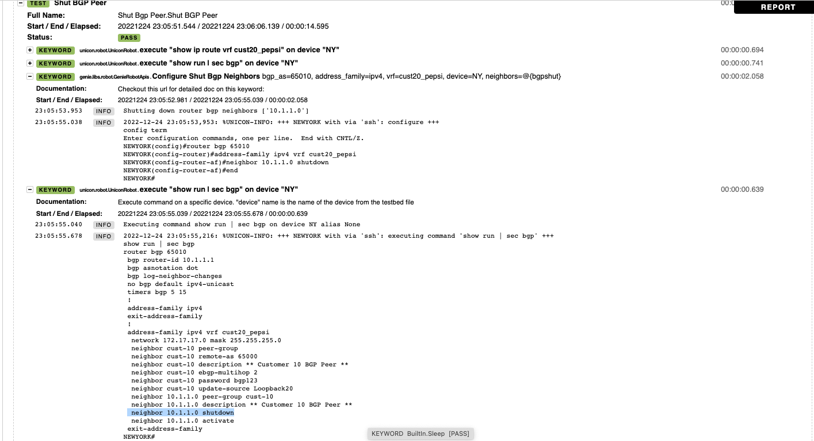
Report – Shut and Unshut BGP Peer
https://github.com/achaanetatuo/pyats/blob/main/report_log/8_shut_bgp_peer.html

Slide 34
Pyats Robot Framework – Configure BGP
# Configure BGP Peer
** Settings ***
Library OperatingSystem
Library ats.robot.pyATSRobot
Library genie.libs.robot.GenieRobot
Library genie.metaparser
Library genie.libs.parser
Library genie.libs.robot.GenieRobotApis
Library unicon.robot.UniconRobot
*** Variables ***
# Defining variables that can be used elsewhere in the test data.
# Can also be driven as dash argument at runtime
${testbed} tb-jump.yaml
# ${PTS} /path/file
*** Test Cases ***
# Creating test cases from available keywords.
Connect
use testbed "${testbed}"
connect to devices "DAL"
connect to devices "NY"
Configure New BGP Peer
execute "show run | sec bgp" on device "DAL"
configure "router bgp 65000\r address-family ipv4 vrf cust60\r neighbor cust-0060 peer-group\r neighbor cust-0060 remote-as 65060 " on device "DAL"
configure "router bgp 65000\r address-family ipv4 vrf cust60\r neighbor cust-0060 ebgp-multihop 2\r neighbor cust-0060 password bgp123 " on device "DAL"
configure "router bgp 65000\r address-family ipv4 vrf cust60\r neighbor 10.1.1.16 peer-group cust-0060\r neighbor 10.1.1.16 activate " on device "DAL"
configure "router bgp 65000\r address-family ipv4 vrf cust60\r neighbor 10.1.1.16 description ** cust-0060-bgp-a ** " on device "DAL"
execute "show run | sec bgp" on device "DAL"
# Disconnect from all the devices
Disconnect
disconnect from all devices
Mac-Pro-641 robot % robot config_bgp.robot
==============================================================================
Config Bgp
==============================================================================
Connect | PASS |
------------------------------------------------------------------------------
Configure New BGP Peer | PASS |
------------------------------------------------------------------------------
Disconnect | PASS |
------------------------------------------------------------------------------
Config Bgp | PASS |
3 tests, 3 passed, 0 failed
==============================================================================
Output: /Users/chandranath/myfolder/autolearn/robot/output.xml
Log: /Users/chandranath/myfolder/autolearn/robot/log.html
Report: /Users/chandranath/myfolder/autolearn/robot/report.html

Slide 35
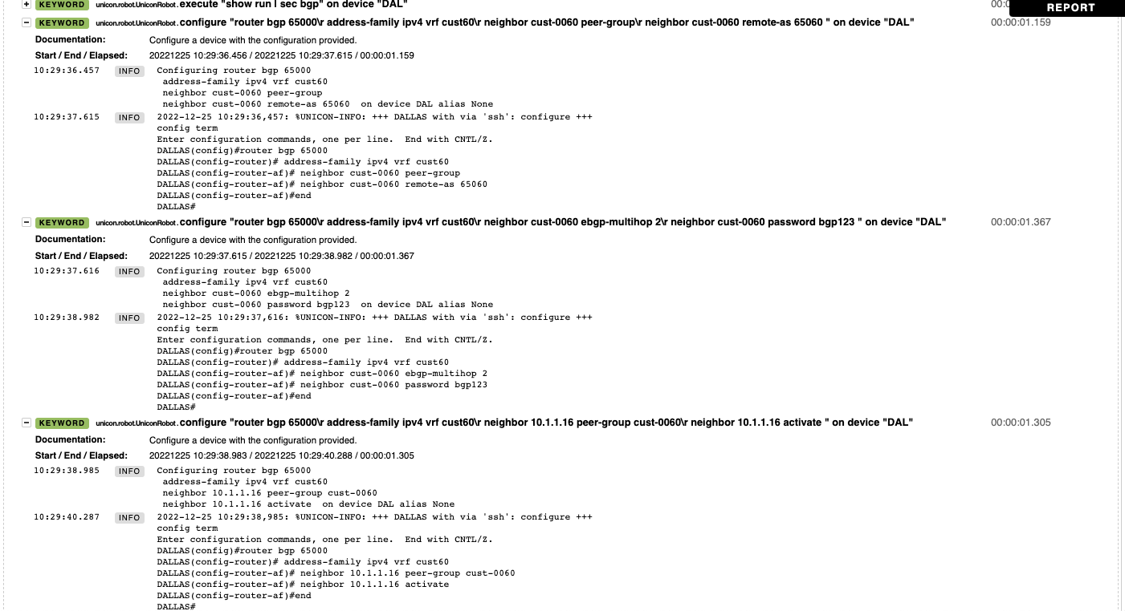
Report – Configure BGP
https://github.com/achaanetatuo/pyats/blob/main/report_log/9_config_bgp.html

Slide 36
Pyats Robot Framework – Verify BGP
# Verify BGP
** Settings ***
Library OperatingSystem
Library ats.robot.pyATSRobot
Library genie.libs.robot.GenieRobot
Library genie.metaparser
Library genie.libs.parser
Library genie.libs.robot.GenieRobotApis
Library unicon.robot.UniconRobot
*** Variables ***
# Defining variables that can be used elsewhere in the test data.
# Can also be driven as dash argument at runtime
${testbed} tb-jump.yaml
# ${PTS} /path/file
*** Test Cases ***
# Creating test cases from available keywords.
Connect
use testbed "${testbed}"
connect to devices "DAL"
connect to devices "NY"
Verify BGP Information
verify count "2" "bgp routes" on device "NY"
verify count "1" "bgp neighbors" on device "NY"
# Disconnect from all the devices
Disconnect
disconnect from all devices
Mac-Pro-641 robot % robot verify_bgp.robot
==============================================================================
Verify Bgp
==============================================================================
Connect | PASS |
------------------------------------------------------------------------------
Verify BGP Information | PASS |
------------------------------------------------------------------------------
Disconnect | PASS |
------------------------------------------------------------------------------
Verify Bgp | PASS |
3 tests, 3 passed, 0 failed
==============================================================================
Output: /Users/chandranath/myfolder/autolearn/robot/output.xml
Log: /Users/chandranath/myfolder/autolearn/robot/log.html
Report: /Users/chandranath/myfolder/autolearn/robot/report.html

Slide 37
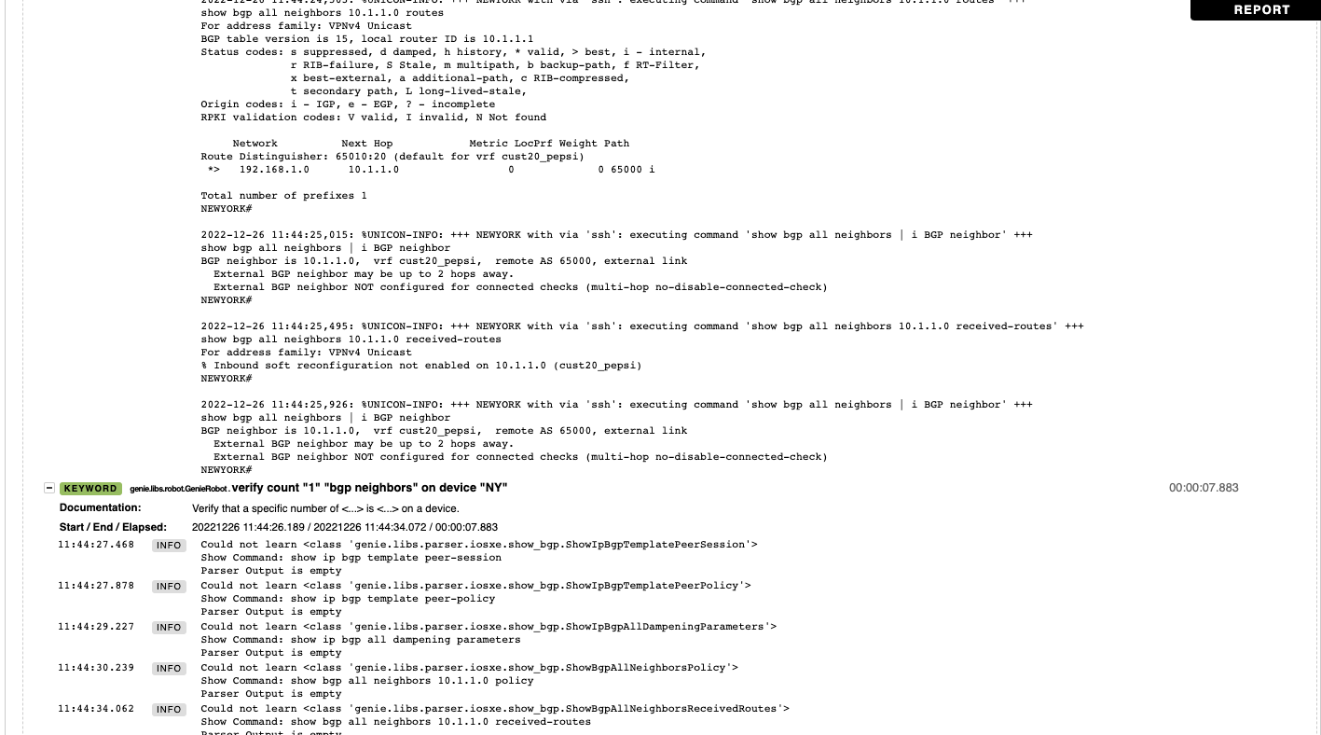
Report – Verify BGP
https://github.com/achaanetatuo/pyats/blob/main/report_log/10_verify_bgp.html

Slide 38
Pyats Robot Framework – Load and Save Configuration
# Load and Save Configuration
** Settings ***
Library OperatingSystem
Library ats.robot.pyATSRobot
Library genie.libs.robot.GenieRobot
Library genie.metaparser
Library genie.libs.parser
Library genie.libs.robot.GenieRobotApis
Library unicon.robot.UniconRobot
*** Variables ***
# Defining variables that can be used elsewhere in the test data.
# Can also be driven as dash argument at runtime
${testbed} tb-jump.yaml
${CONFIG} /Users/Mac-Pro-641/myfolder/autolearn/robot/loopback600.cfg
# ${PTS} /path/file
*** Test Cases ***
# Creating test cases from available keywords.
Connect
use testbed "${testbed}"
connect to devices "DAL"
connect to devices "NY"
Load and Save Configuration
${configuration}= get file ${CONFIG}
configure "${configuration}" on device "DAL"
${output}= execute "write" on device "DAL"
execute "show run interface loopback600 " on device "DAL"
# Disconnect from all the devices
Disconnect
disconnect from all devices
Mac-Pro-641 robot % robot load_config.robot
==============================================================================
Load Config
==============================================================================
Connect | PASS |
------------------------------------------------------------------------------
Load and Save Configuration | PASS |
------------------------------------------------------------------------------
Disconnect | PASS |
------------------------------------------------------------------------------
Load Config | PASS |
3 tests, 3 passed, 0 failed
==============================================================================
Output: /Users/chandranath/myfolder/autolearn/robot/output.xml
Log: /Users/chandranath/myfolder/autolearn/robot/log.html
Report: /Users/chandranath/myfolder/autolearn/robot/report.html
loopback600.cfg
interface Loopback600
description customer-600
vrf forwarding cust600
ip address 10.1.1.160 255.255.255.255
no shutdown

Slide 39
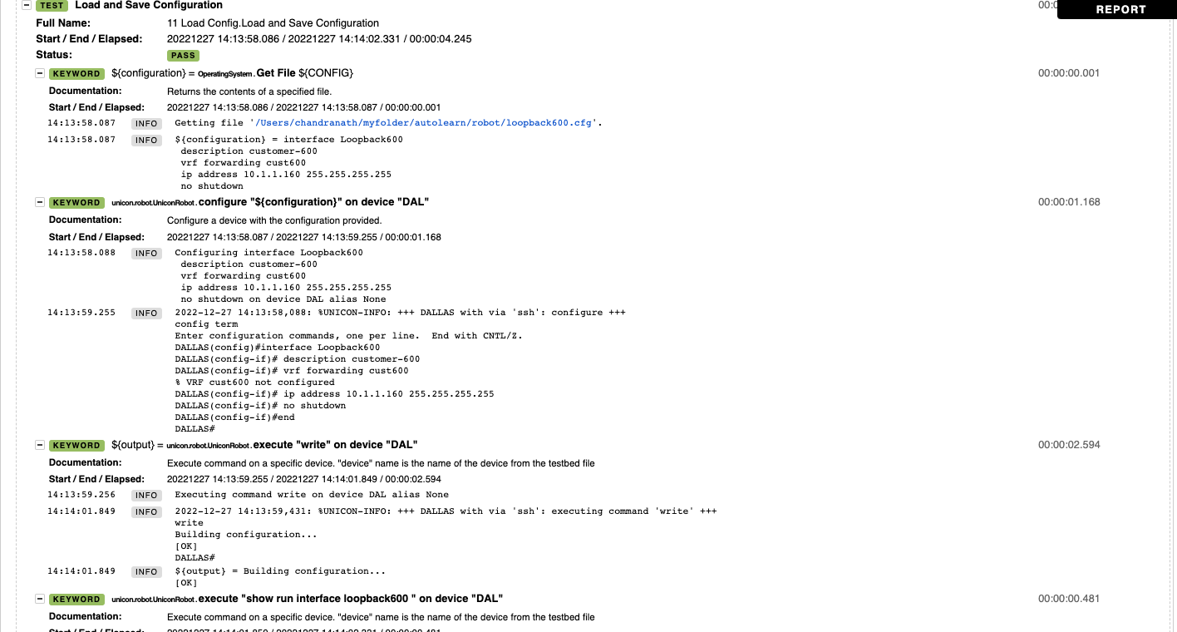
Report – Load and Save Configuration
https://github.com/achaanetatuo/pyats/blob/main/report_log/11_load_config.html

Slide 40
Pyats Robot Framework – Genie Models
Genie Models contains a list of possible commands for specific operation. You can store an output in a file and compare pre and post changes of your device's configuration.
Example :
config
bgp
acl
routing
static_routing
arp
interface
etc….
Refernce: https://pubhub.devnetcloud.com/media/genie-feature-browser/docs/#/models

Slide 41
Pyats Robot Framework – Configuration Model
# Show Running Configuration
** Settings ***
Library OperatingSystem
Library ats.robot.pyATSRobot
Library genie.libs.robot.GenieRobot
Library genie.libs.robot.GenieRobotApis
Library unicon.robot.UniconRobot
*** Variables ***
# Defining variables that can be used elsewhere in the test data.
# Can also be driven as dash argument at runtime
${testbed} tb-jump.yaml
# ${PTS} /path/file
*** Test Cases ***
# Creating test cases from available keywords.
Connect
use testbed "${testbed}"
connect to devices "DAL"
connect to devices "NY"
# Dallas Model Configuration
DAL Running Configuration
Profile the system for "config" on devices "DAL" as "./DAL_base_config"
# Newyork Model Configuration
NY Running Configuration
Profile the system for "config" on devices "DAL" as "./NY_base_config"
# Disconnect from all the devices
Disconnect
disconnect from all devices
Mac-Pro-641 robot % robot model_config.robot
==============================================================================
Model Config
==============================================================================
Connect | PASS |
------------------------------------------------------------------------------
DAL Running Configuration | PASS |
------------------------------------------------------------------------------
NY Running Configuration | PASS |
------------------------------------------------------------------------------
Disconnect | PASS |
------------------------------------------------------------------------------
Model Config | PASS |
4 tests, 4 passed, 0 failed
==============================================================================
Output: /Users/chandranath/myfolder/autolearn/robot/output.xml
Log: /Users/chandranath/myfolder/autolearn/robot/log.html
Report: /Users/chandranath/myfolder/autolearn/robot/report.html
**Profile keywork is used to run pyATS models.

Slide 42
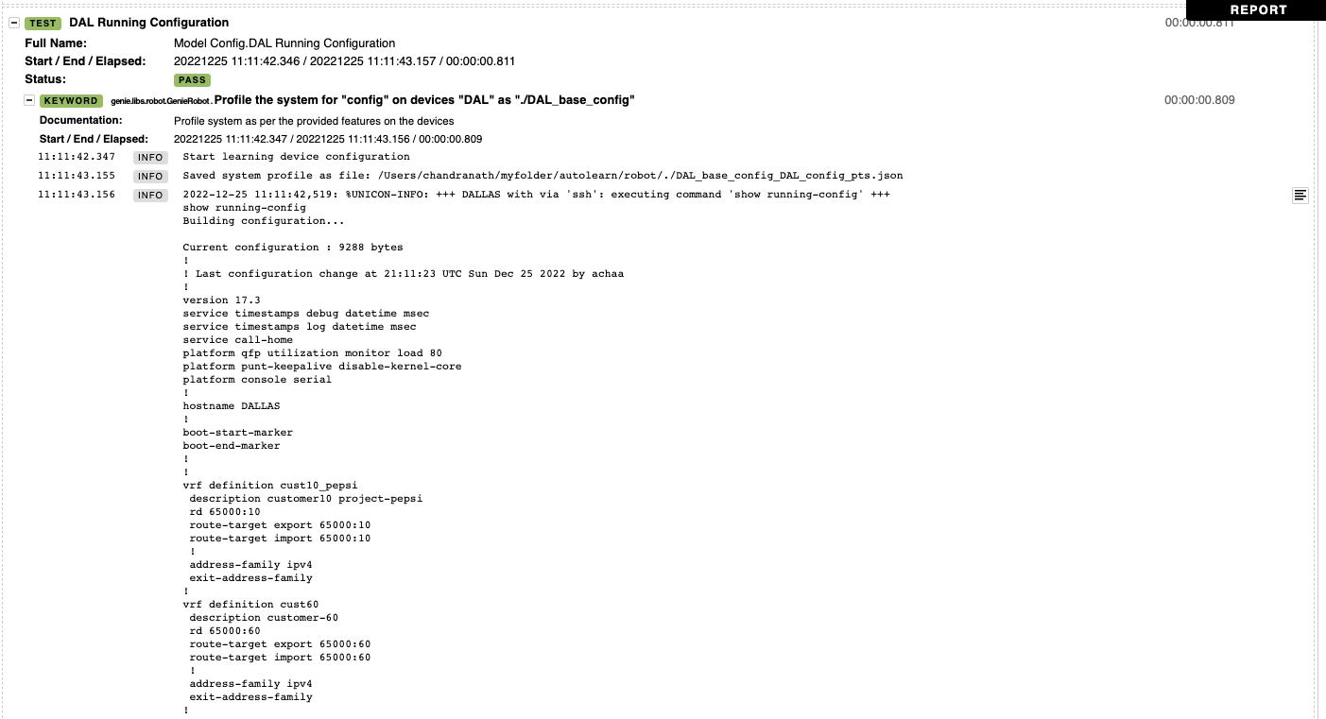
Report – Configuration Model
https://github.com/achaanetatuo/pyats/blob/main/report_log/12_Model_config.html

Slide 43
Pyats Robot Framework – Routing Model
# Routing Model
** Settings ***
Library OperatingSystem
Library ats.robot.pyATSRobot
Library genie.libs.robot.GenieRobot
Library genie.libs.robot.GenieRobotApis
Library unicon.robot.UniconRobot
*** Variables ***
# Defining variables that can be used elsewhere in the test data.
# Can also be driven as dash argument at runtime
${testbed} tb-jump.yaml
# ${PTS} /path/file
*** Test Cases ***
# Creating test cases from available keywords.
Connect
use testbed "${testbed}"
connect to devices "DAL"
connect to devices "NY"
# Dallas Model Routing
DAL Model Routing
Profile the system for "routing" on devices "DAL" as "./DAL_base_config"
# Newyork Model Routing
NY Model Routing
Profile the system for "routing" on devices "DAL" as "./NY_base_config"
# Disconnect from all the devices
Disconnect
disconnect from all devices
Mac-Pro-641 robot % robot model_routing.robot
==============================================================================
Model Routing
==============================================================================
Connect | PASS |
------------------------------------------------------------------------------
DAL Model Routing | PASS |
------------------------------------------------------------------------------
NY Model Routing | PASS |
------------------------------------------------------------------------------
Disconnect | PASS |
------------------------------------------------------------------------------
Model Routing | PASS |
4 tests, 4 passed, 0 failed
==============================================================================
Output: /Users/chandranath/myfolder/autolearn/robot/output.xml
Log: /Users/chandranath/myfolder/autolearn/robot/log.html
Report: /Users/chandranath/myfolder/autolearn/robot/report.html

Slide 44
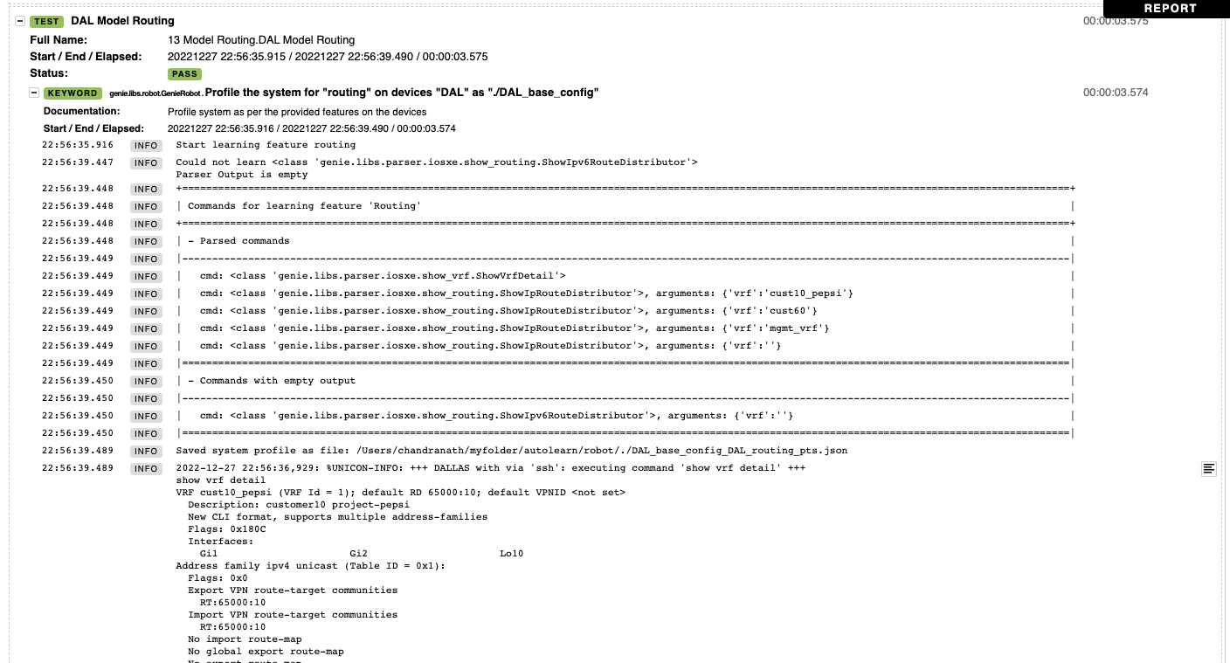
Report – Routing Model
https://github.com/achaanetatuo/pyats/blob/main/report_log/13_model_routing.html

Slide 45
Pyats Robot Framework – BGP Model
# BGP Model
** Settings ***
Library OperatingSystem
Library ats.robot.pyATSRobot
Library genie.libs.robot.GenieRobot
Library genie.libs.robot.GenieRobotApis
Library unicon.robot.UniconRobot
*** Variables ***
# Defining variables that can be used elsewhere in the test data.
# Can also be driven as dash argument at runtime
${testbed} tb-jump.yaml
# ${PTS} /path/file
*** Test Cases ***
# Creating test cases from available keywords.
Connect
use testbed "${testbed}"
connect to devices "DAL"
connect to devices "NY"
# Dallas Model BGP
DAL Model BGP
Profile the system for "bgp" on devices "DAL" as "./DAL_base_config"
# Newyork Model BGP
NY Model BGP
Profile the system for "bgp" on devices "DAL" as "./NY_base_config"
# Disconnect from all the devices
Disconnect
disconnect from all devices
Mac-Pro-641 robot % robot model_bgp.robot
==============================================================================
Model Bgp
==============================================================================
Connect | PASS |
------------------------------------------------------------------------------
DAL Model BGP | PASS |
------------------------------------------------------------------------------
NY Model BGP | PASS |
------------------------------------------------------------------------------
Disconnect | PASS |
------------------------------------------------------------------------------
Model Bgp | PASS |
4 tests, 4 passed, 0 failed
==============================================================================
Output: /Users/chandranath/myfolder/autolearn/robot/output.xml
Log: /Users/chandranath/myfolder/autolearn/robot/log.html
Report: /Users/chandranath/myfolder/autolearn/robot/report.html

Slide 46
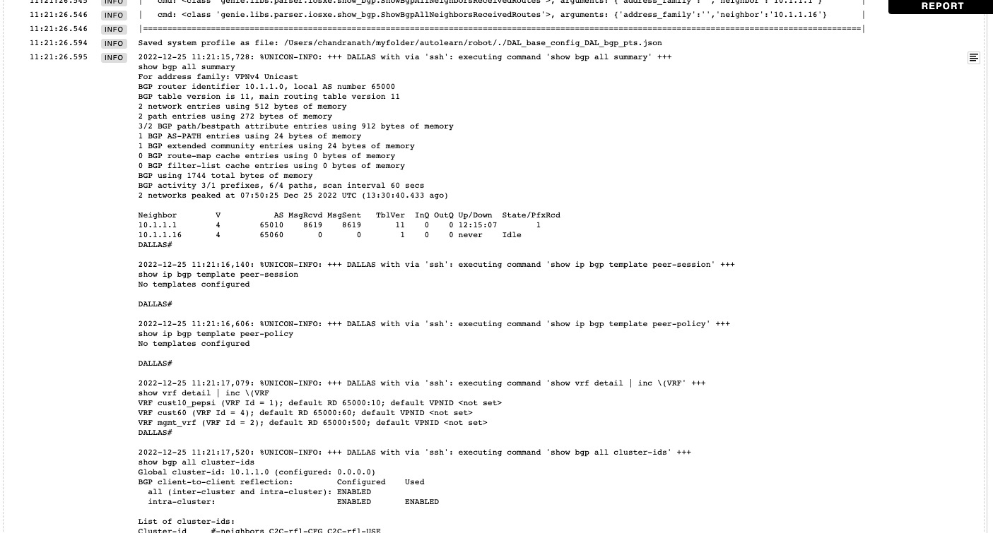
Report – BGP Model
https://github.com/achaanetatuo/pyats/blob/main/report_log/14_model_bgp.html

Slide 47
Pyats Robot Framework – Compare Configuration Model
# Compare Config Models
** Settings ***
Library OperatingSystem
Library ats.robot.pyATSRobot
Library genie.libs.robot.GenieRobot
Library genie.libs.robot.GenieRobotApis
Library unicon.robot.UniconRobot
*** Variables ***
# Defining variables that can be used elsewhere in the test data.
# Can also be driven as dash argument at runtime
${testbed} tb-jump.yaml
# ${PTS} /path/file
*** Test Cases ***
# Creating test cases from available keywords.
Connect
use testbed "${testbed}"
connect to devices "DAL"
connect to devices "NY"
# Dallas Compare Configuration
DAL Current Running Configuration
Profile the system for "config" on devices "DAL" as "./DAL_current_config"
DAL Change Configuration
configure "ip route vrf cust10_pepsi 90.1.1.0 255.255.255.255 100.100.100.1" on device "DAL"
DAL New Running Configuration
Profile the system for "config" on devices "DAL" as "./DAL_new_config"
Compare Current and New Snapshots Dallas
Compare profile "./DAL_current_config" with "./DAL_new_config" on devices "DAL"
# Disconnect from all the devices
Disconnect
disconnect from all devices
Mac-Pro-641 robot % robot model_compare_config.robot
==============================================================================
Model Compare Config
==============================================================================
Connect | PASS |
------------------------------------------------------------------------------
DAL Current Running Configuration | PASS |
------------------------------------------------------------------------------
DAL Change Configuration | PASS |
------------------------------------------------------------------------------
DAL New Running Configuration | PASS |
------------------------------------------------------------------------------
Compare Current and New Snapshots Dallas | FAIL |
**********
Comparison between ./DAL_current_config and ./DAL_new_config is different for feature 'config' for device:
'DAL'
+ip route vrf cust10_pepsi 90.1.1.0 255.255.255.255 100.100.100.1
------------------------------------------------------------------------------
Disconnect | PASS |
------------------------------------------------------------------------------
Model Compare Config | FAIL |
6 tests, 5 passed, 1 failed
==============================================================================
Output: /Users/chandranath/myfolder/autolearn/robot/output.xml
Log: /Users/chandranath/myfolder/autolearn/robot/log.html
Report: /Users/chandranath/myfolder/autolearn/robot/report.html
**FAIL means there is a difference between the configurations.

Slide 48
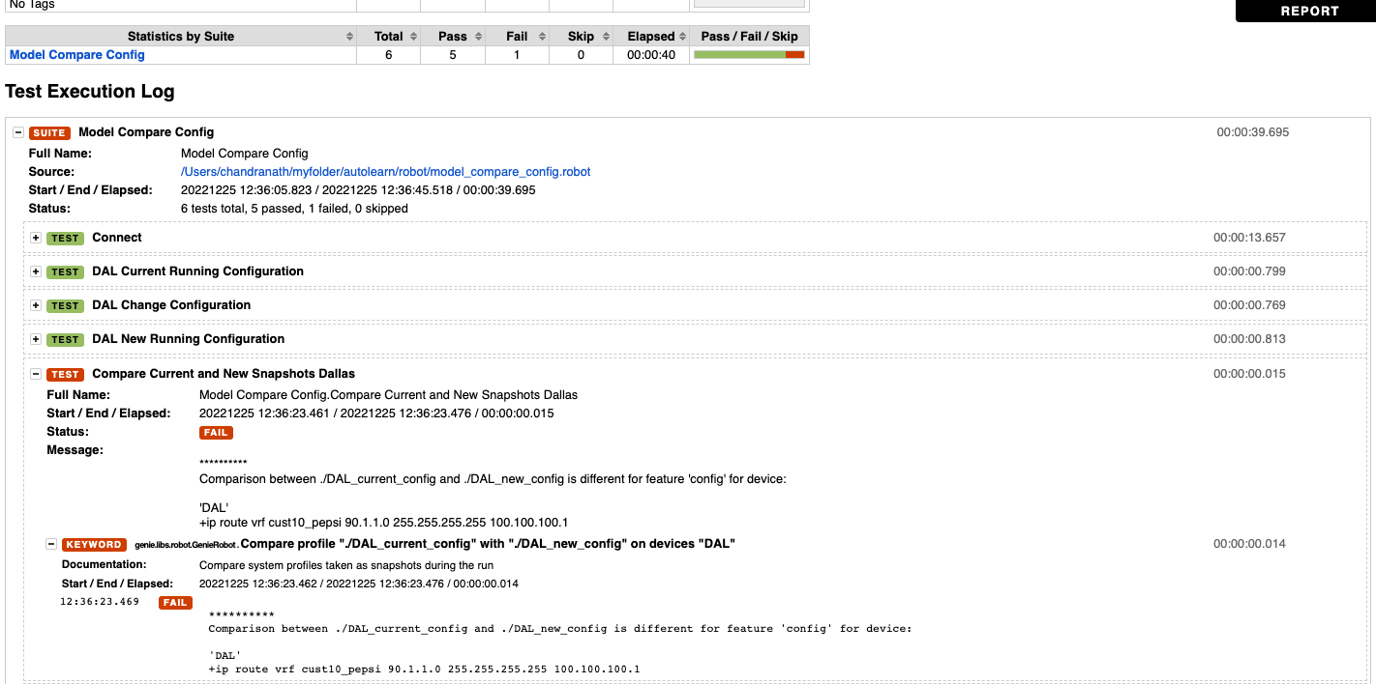
Report – Compare Configuration Model
https://github.com/achaanetatuo/pyats/blob/main/report_log/15_model_compare_config.html

Slide 49
Pyats Robot Framework – Compare Interface Model
# Compare Interface Models
** Settings ***
Library OperatingSystem
Library ats.robot.pyATSRobot
Library genie.libs.robot.GenieRobot
Library genie.libs.robot.GenieRobotApis
Library unicon.robot.UniconRobot
*** Variables ***
# Defining variables that can be used elsewhere in the test data.
${testbed} tb-jump.yaml
${CONFIG} /Users/chandranath/myfolder/autolearn/robot/loopback7777.cfg
# ${PTS} /path/file
*** Test Cases ***
# Creating test cases from available keywords.
Connect
use testbed "${testbed}"
connect to devices "DAL"
# Dallas Compare Configuration
DAL Current Running Configuration
Profile the system for "interface" on devices "DAL" as "./DAL_current_interface"
DAL Change Configuration
${configuration}= get file ${CONFIG}
configure "${configuration}" on device "DAL"
${output}= execute "write" on device "DAL"
execute "show run interface loopback7777 " on device "DAL"
DAL New Running Configuration
Profile the system for "interface" on devices "DAL" as "./DAL_new_interface"
Compare Current and New Snapshots Dallas
Compare profile "./DAL_current_interface" with "./DAL_new_interface" on devices "DAL"
# Disconnect from all the devices
Disconnect
disconnect from all devices

Slide 50
Pyats Robot Framework – Compare Interface Model - CLI Output
chandranath@Chandranaths-Mac-Pro-641 robot % robot model_compare_interface.robot
==============================================================================
Model Compare Interface
==============================================================================
Connect | PASS |
------------------------------------------------------------------------------
DAL Current Running Configuration | PASS |
------------------------------------------------------------------------------
DAL Change Configuration | PASS |
------------------------------------------------------------------------------
DAL New Running Configuration | PASS |
------------------------------------------------------------------------------
Compare Current and New Snapshots Dallas | FAIL |
**********
Comparison between ./DAL_current_interface and ./DAL_new_interface is different for feature 'interface' for device:
'DAL'
info:
+ Loopback7777:
+ bandwidth: 8000000
+ counters:
+ in_broadcast_pkts: 0
+ in_crc_errors: 0
+ in_errors: 0
+ in_multicast_pkts: 0
+ in_octets: 0
+ in_pkts: 0
+ last_clear: never
+ out_broadcast_pkts: 0
+ out_errors: 0
+ out_multicast_pkts: 0
[ Message content over the limit has been removed. ]
+ in_rate_pkts: 0
+ load_interval: 300
+ out_rate: 0
+ out_rate_pkts: 0
+ delay: 5000
+ description: customer-7777
+ enabled: True
+ encapsulation:
+ encapsulation: loopback
+ ipv4:
+ 10.77.77.77/32:
+ ip: 10.77.77.77
+ prefix_length: 32
+ secondary: False
+ mtu: 1514
+ oper_status: up
+ port_channel:
+ port_channel_member: False
+ switchport_enable: False
+ type: Loopback
------------------------------------------------------------------------------
Disconnect | PASS |
------------------------------------------------------------------------------
Model Compare Interface | FAIL |
6 tests, 5 passed, 1 failed
==============================================================================
Output: /Users/chandranath/myfolder/autolearn/robot/output.xml
Log: /Users/chandranath/myfolder/autolearn/robot/log.html
Report: /Users/chandranath/myfolder/autolearn/robot/report.html

Slide 51
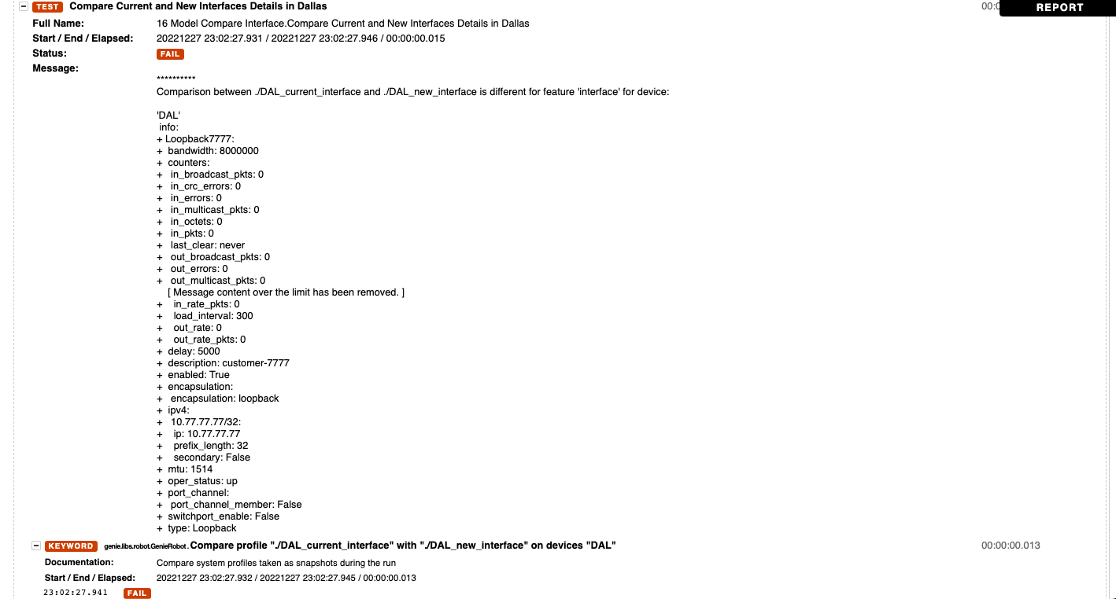
Report – Compare Interface Model - Report
https://github.com/achaanetatuo/pyats/blob/main/report_log/16_model_compare_interface.html

Slide 52
Pyats Robot Framework – Interface/ARP Model
# Interface and ARP Model
** Settings ***
Library OperatingSystem
Library ats.robot.pyATSRobot
Library genie.libs.robot.GenieRobot
Library genie.libs.robot.GenieRobotApis
Library unicon.robot.UniconRobot
*** Variables ***
# Defining variables that can be used elsewhere in the test data.
# Can also be driven as dash argument at runtime
${testbed} tb-jump.yaml
# ${PTS} /path/file
*** Test Cases ***
# Creating test cases from available keywords.
Connect
use testbed "${testbed}"
connect to devices "DAL"
connect to devices "NY"
# Dallas Model Interface and ARP
DAL Model Interface and ARP
Profile the system for "interface;arp" on devices "DAL" as "./DAL_base_int_config"
# Newyork Model Interface and ARP
NY Model Interface and ARP
Profile the system for "interface;arp" on devices "DAL" as "./NY_base_int_config"
# Disconnect from all the devices
Disconnect
disconnect from all devices
Mac-Pro-641 robot % robot model_interface_arp.robot
==============================================================================
Model Interface Arp
==============================================================================
Connect | PASS |
------------------------------------------------------------------------------
DAL Model Interface and ARP | PASS |
------------------------------------------------------------------------------
NY Model Interface and ARP | PASS |
------------------------------------------------------------------------------
Disconnect | PASS |
------------------------------------------------------------------------------
Model Interface Arp | PASS |
4 tests, 4 passed, 0 failed
==============================================================================
Output: /Users/chandranath/myfolder/autolearn/robot/output.xml
Log: /Users/chandranath/myfolder/autolearn/robot/log.html
Report: /Users/chandranath/myfolder/autolearn/robot/report.html

Slide 53
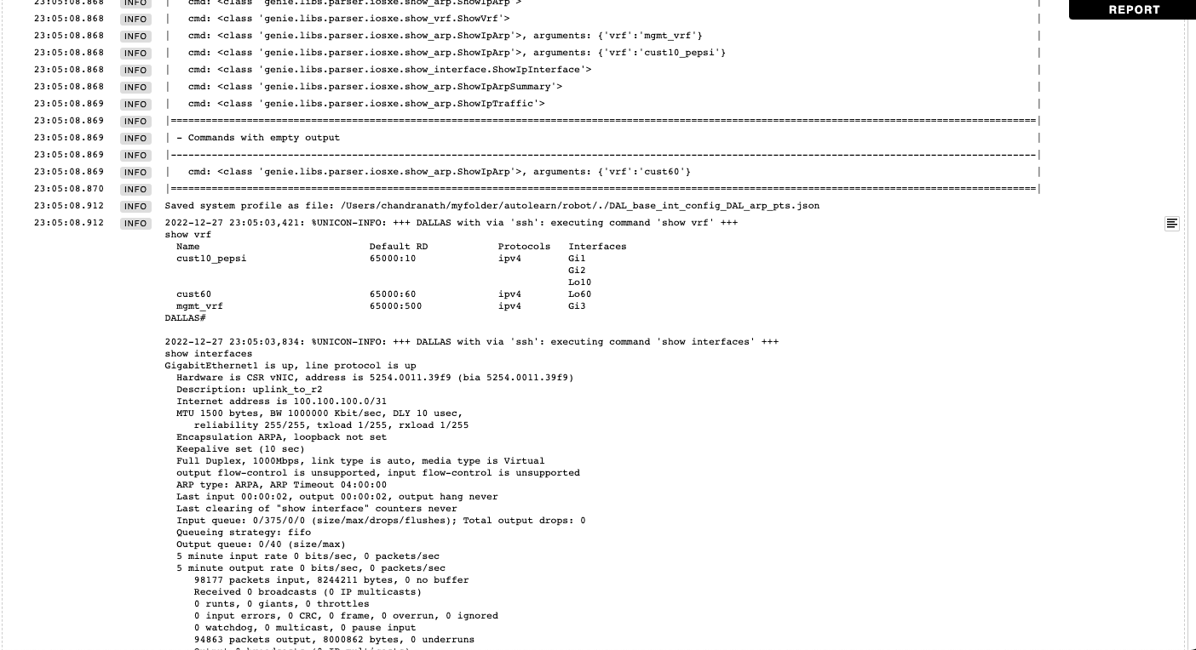
Report – Interface/ARP Model
https://github.com/achaanetatuo/pyats/blob/main/report_log/17_model_interface_arp.html

Slide 54
Backup Slides

Slide 55
Network Automation Solutions
Volume-2
Coming Soon …
Python
Author :
Ankit Chhawsaria
Chandranath Malli Amarnath

Slide 56
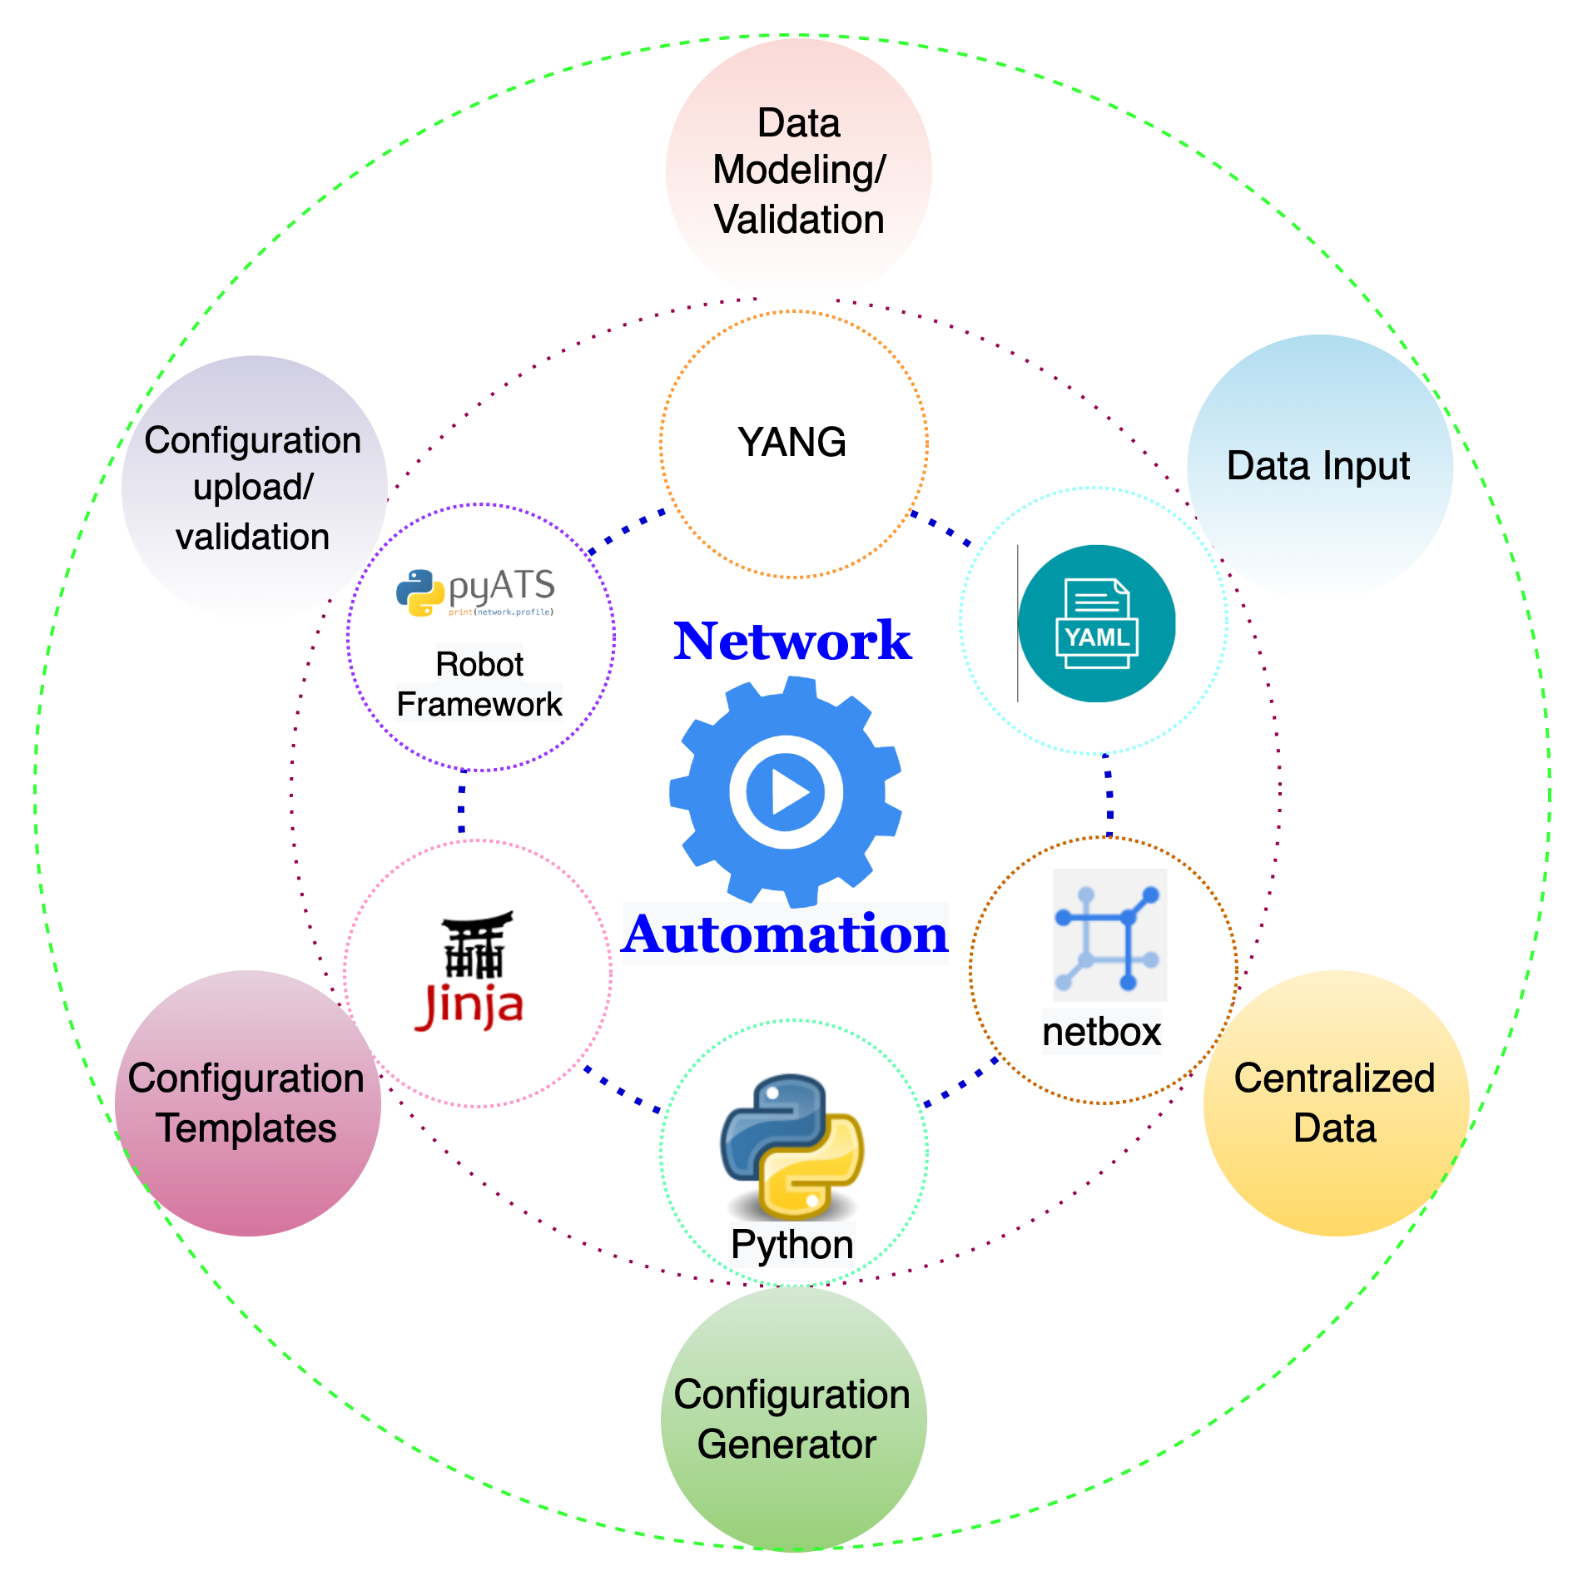
Network Automation Tools

